Slide 1
Performance Gain related to MSRP
Chris Le, Robert Bonham, Carson Holland

Slide 2
Goals/Overview
The primary objective of this project is to assess performance gains year-to-year based off MSRP
Intel(x86) – ARM switch

Slide 3
Expectations
Macbooks with ARM perform better than the Intel variant
Performance of the 2021 ARM should be better than the 2020 ARM
Heat may play a factor in the Minecraft tests

Slide 4

Mac Specs
Year | Architecture | Processor | CPU Cores | RAM (GB) | MSRP ($)
2019 | X86 | 8th Gen Intel I5 | 4 | 8 | 1,299
2020 | ARM | M1 | 8 | 8 | 1,299
2021 | ARM | M1 Pro | 10 | 16 | 2,499

Slide 5
Performance Benchmarks
Scale.c, Quicksort.cpp, Ranksort.c
Constant data count – increased threads
(Measures parallelism in multi-thread performance)
Constant one thread– increased data count
(Measures the power/speed of one thread) Thread efficiency

Slide 6
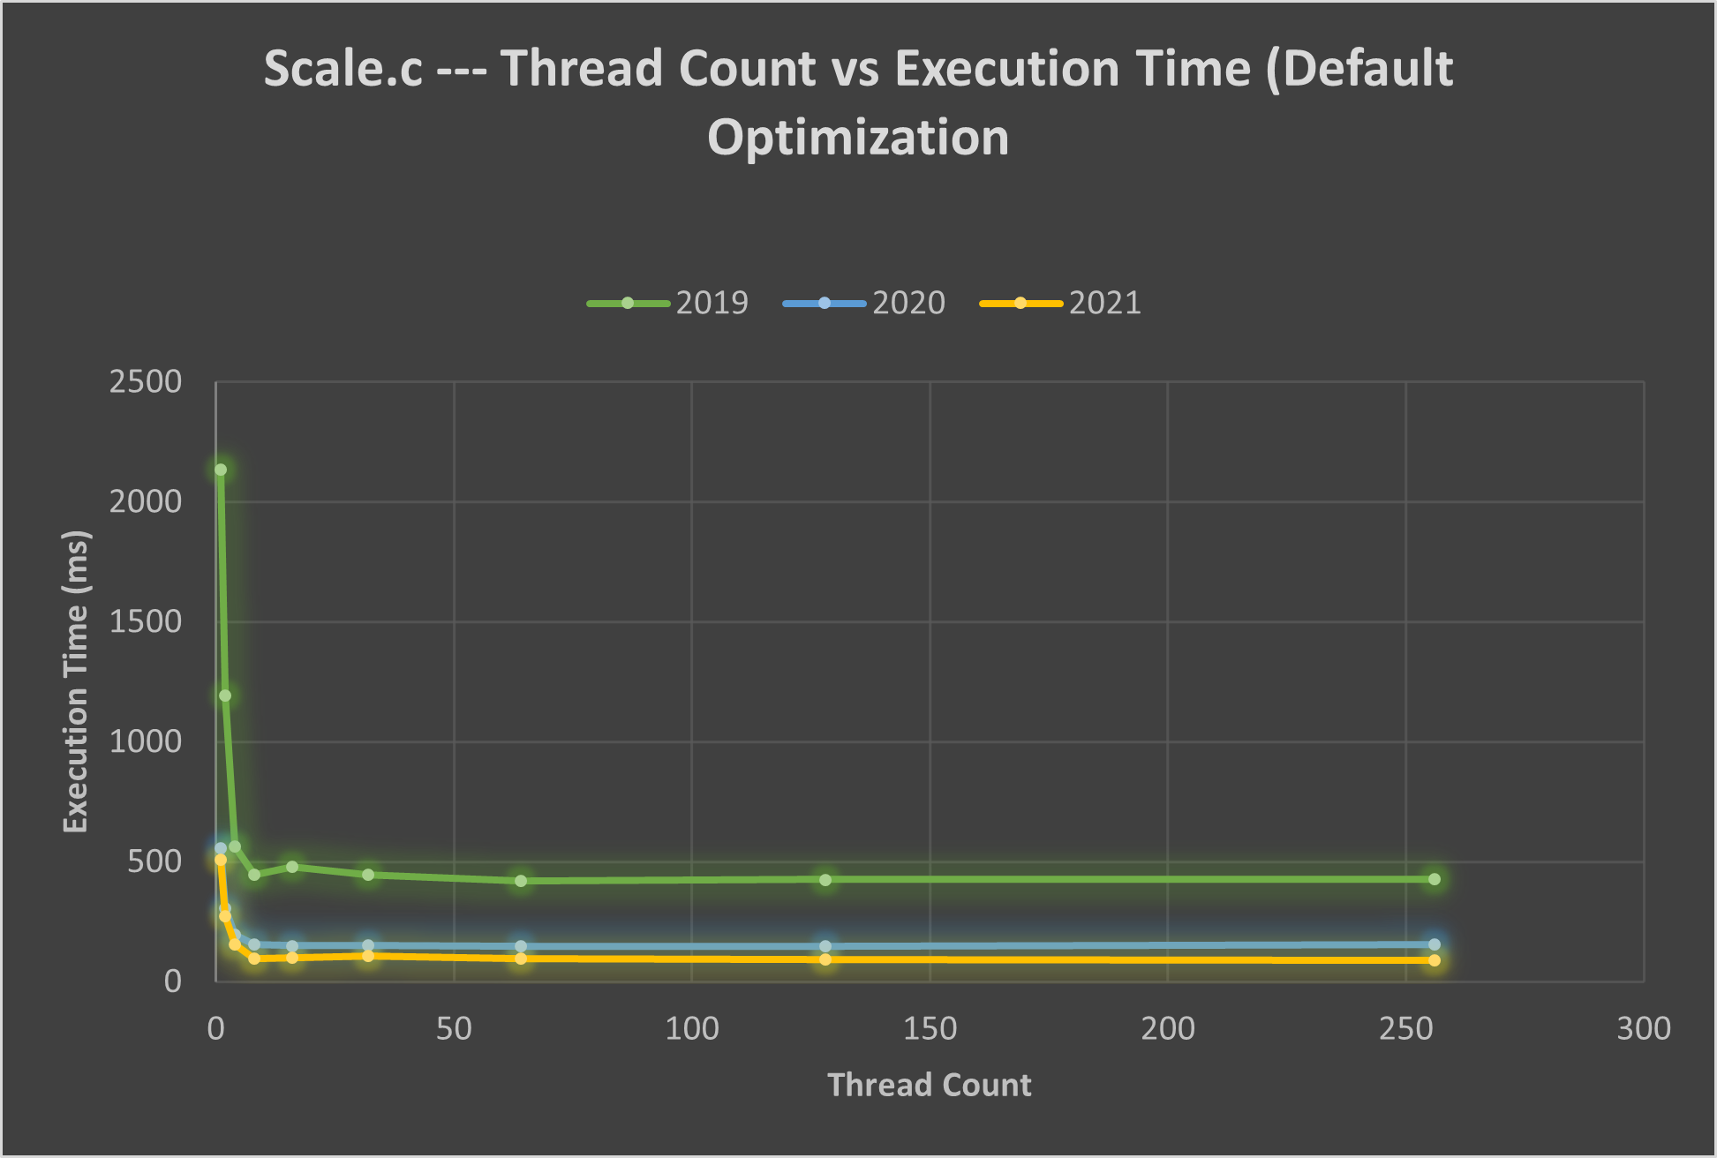
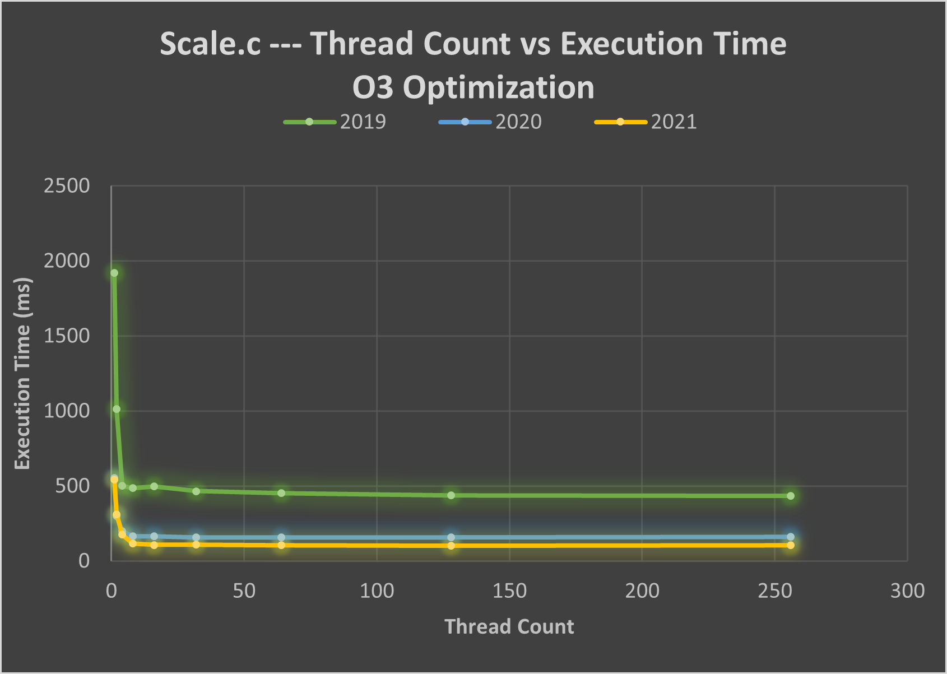
Scale.c Data Thread Count Testing
Lower is better

Slide 7
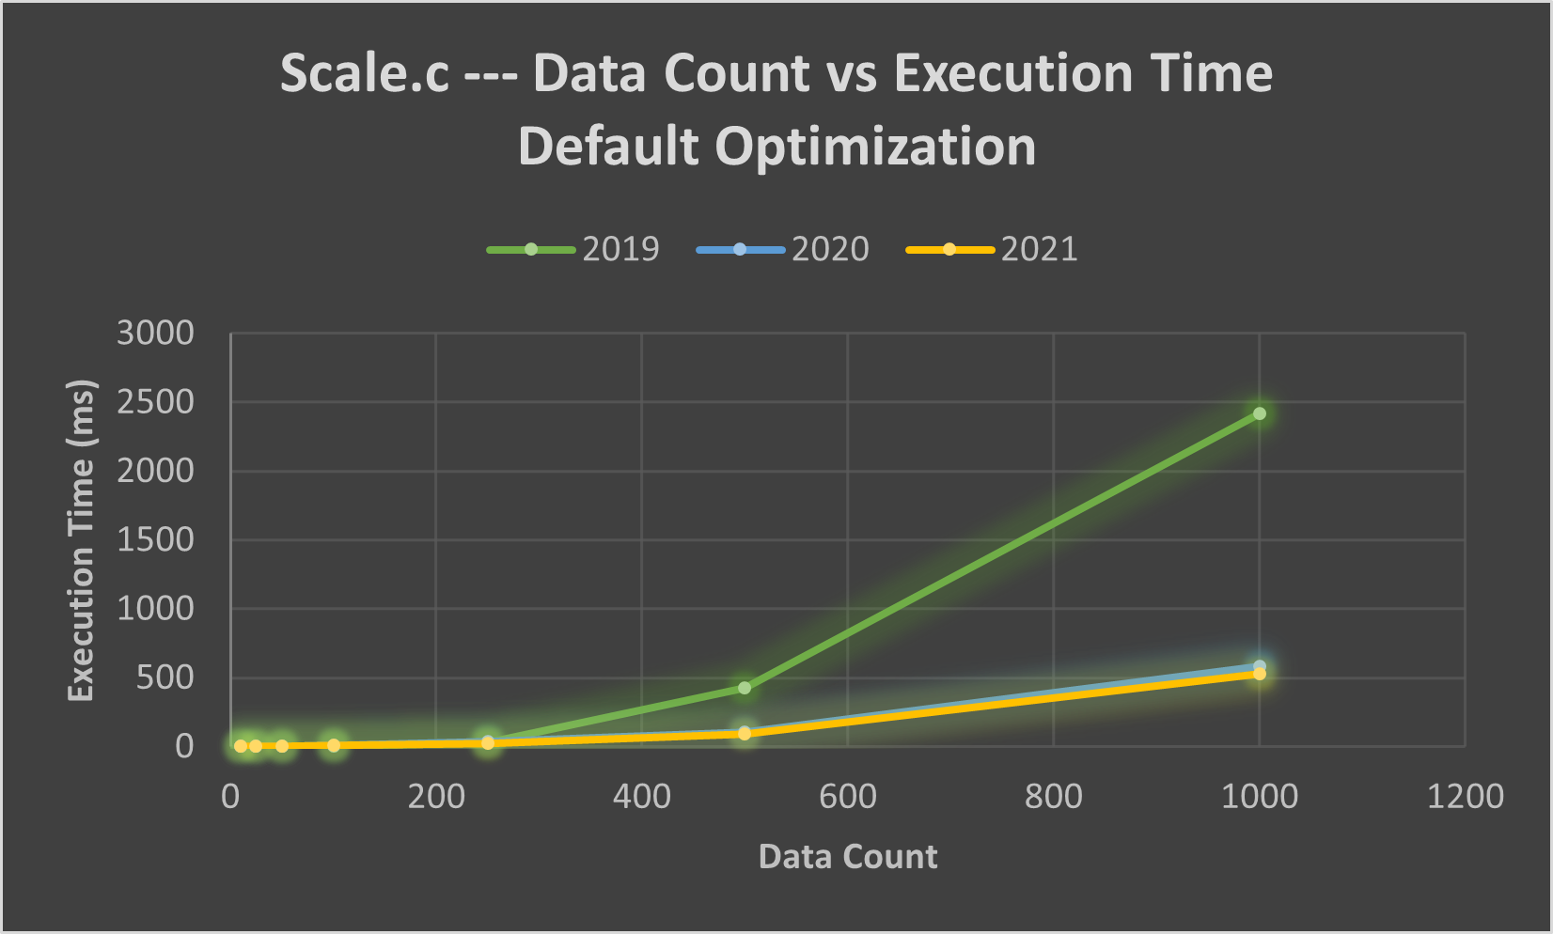
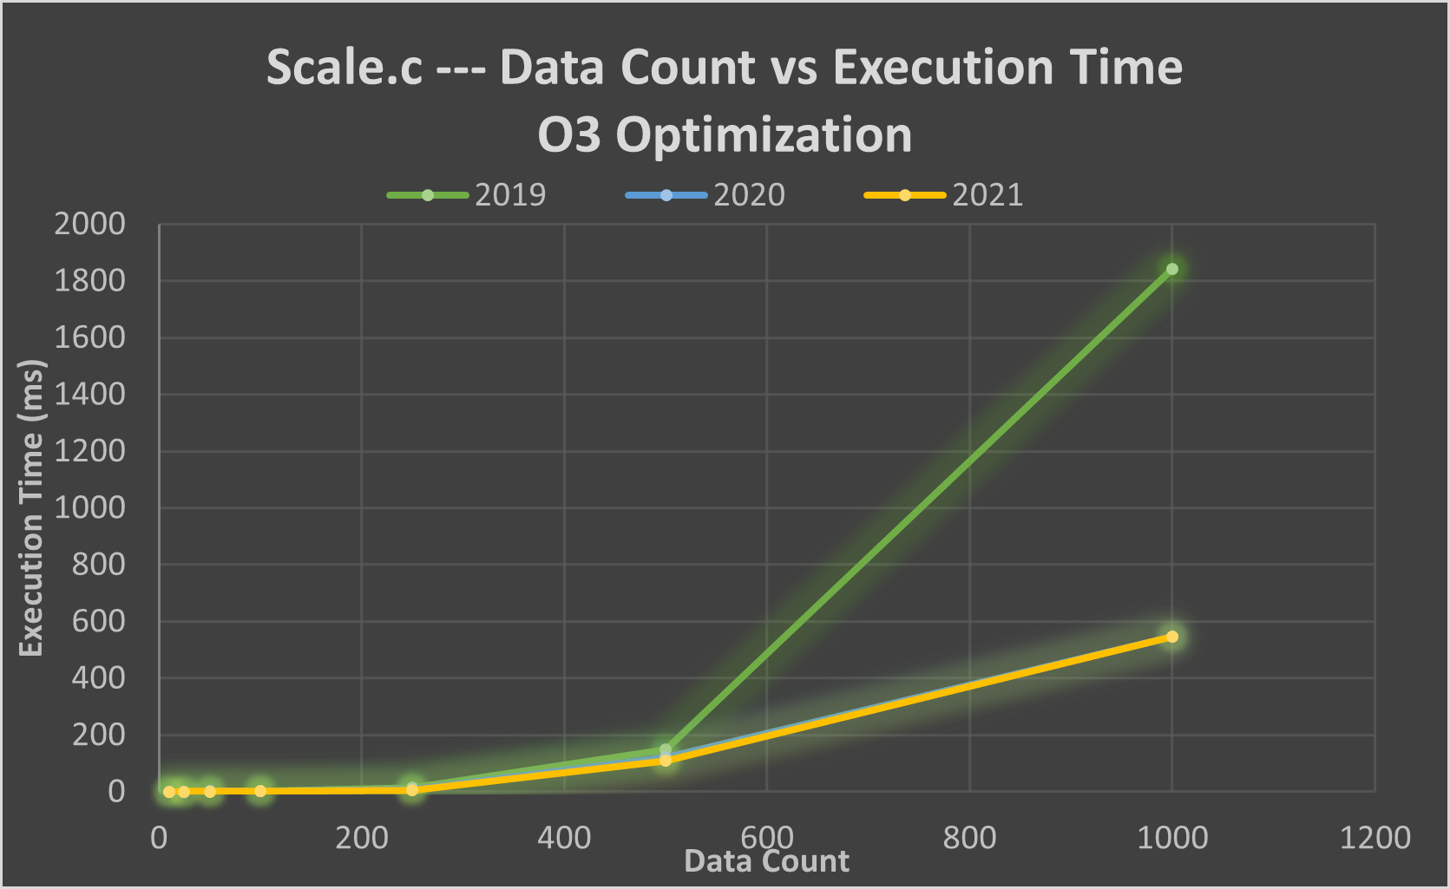
Scale.c Data Count Testing
Lower is better

Slide 8
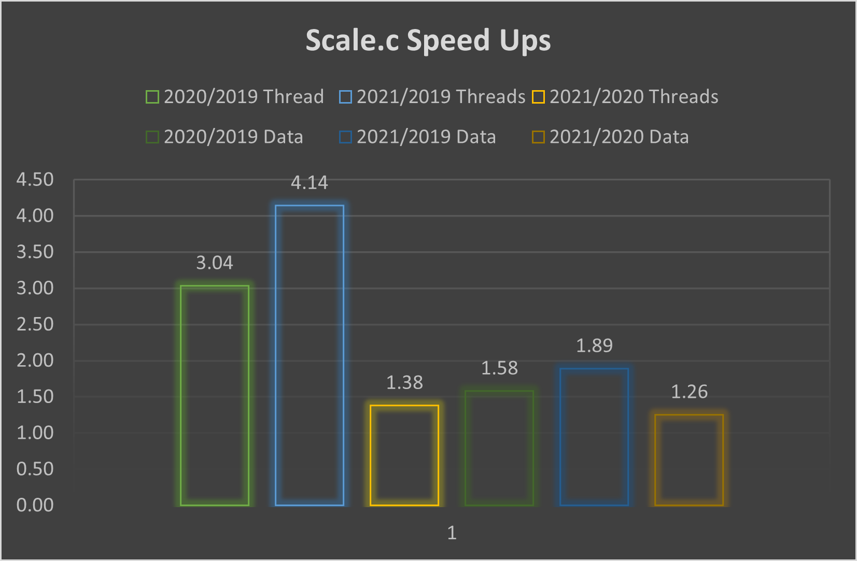
Scale.c Speed Up Ratios

Slide 9
Minecraft Testing
A general, common day to day use case.
Render distance, fast graphics, identical seeds, identical coordinates
Measure CPU temperature and percentages, FPS
Minimal background applications.

Slide 10
Why Minecraft?
Its well known that compared to games on the market. Minecraft is highly CPU intensive(Java version).
Due to needing to load up all the chucks (a 384-block tall 16×16 segment of a world) and then store those chucks once you are out of render distance.
It is literary just blocks.
A lack of poor optimization could have led this more reliance on the CPU.
Java.
Notes:
During a small test on the MacBook Pro 2020, detonating a 10x10x10 cube, the CPU usage when from a idle stage of 50.1% -> during 326.2% and Max at 542% -> resting 150.2%.

Slide 11
Current Thoughts on Data so Far
The switch from x86 to ARM resulted in significantly better performance
Preliminary information indicates heat is a major factor in the Minecraft test
Apple was right to drop Intel

